Slide 1

Location Analysis
To find best location for opening a venue.

Slide 2
Introduction
For prospect businessmen who can afford setting up a restaurant or club etc. in the San Francisco area a preliminary research might be interesting. This research project aims to provide insights in the neighborhoods of the largest Colleges and Universities in San Francisco to open a new venue. What might be interesting is the crime rate of the several serious recorded offences in the neighborhoods when selecting an appropriate place to open a new venue given that the subjects of your choice are available at multiple locations.

Slide 3
Data
The folium package will be used to show OpenStreetMap data.
The Foursquare API provides nearby venues with some additional data.
The https://data.sfgov.org provides the crime rates of 2018.
The http://www.city-data.com/city/San-Francisco-California.html provides the list of Universities and Colleges that will be scraped with BeautifulSoup4 into a Pandas Data Frame. These locations provide the basis for the neighborhood analysis of shops and crime rate.

Slide 4
Methodology
Pandas will be used for data mangling, thus cleaning, reading, grouping and aggregating data in a table formatted style. The beforementioned data sources will be filtered on: the vicinity of the educational location's shops, venues around these locations and crimes by these neighborhoods, crime type and timeliness of occurrences.
Describe the Latitude and Longitude bandwidths of the selected locations for crime and shop-venue selections, plot the crimes in total and per location with a histogram with time-period on the horizontal axis and count on the vertical axis. plot these crimes also per selected main category.
Clustering using K-means and DBSCAN.

Slide 5
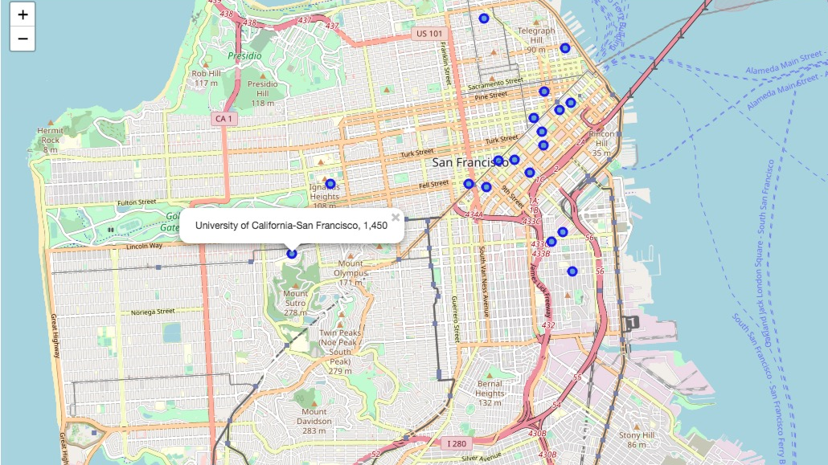
Results

Slide 6
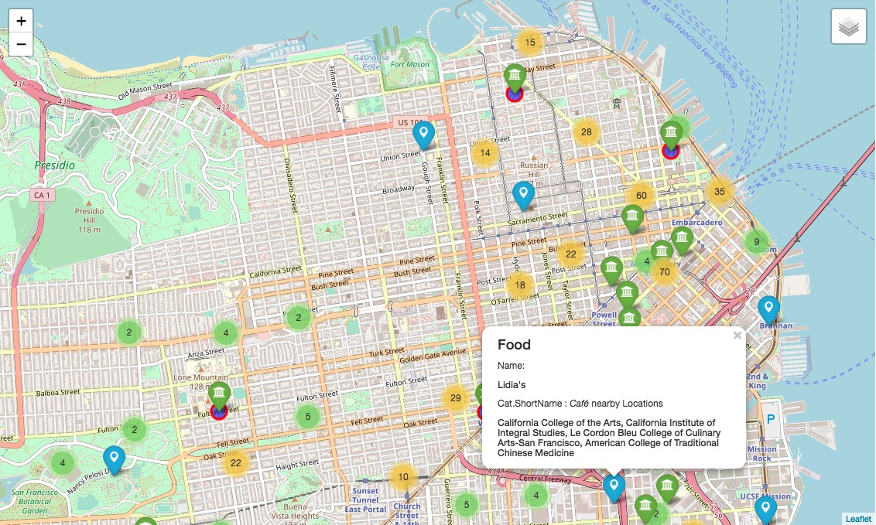

Slide 7
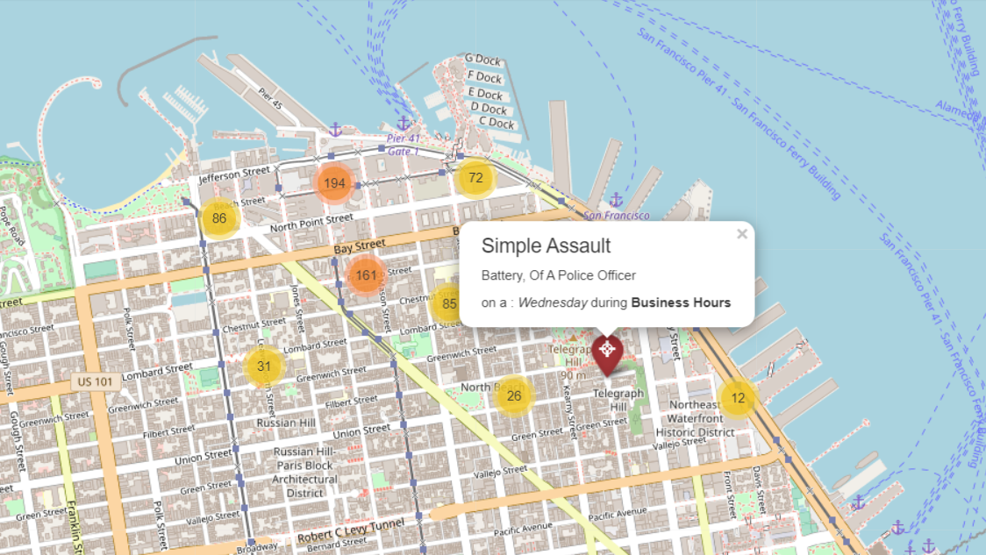

Slide 8
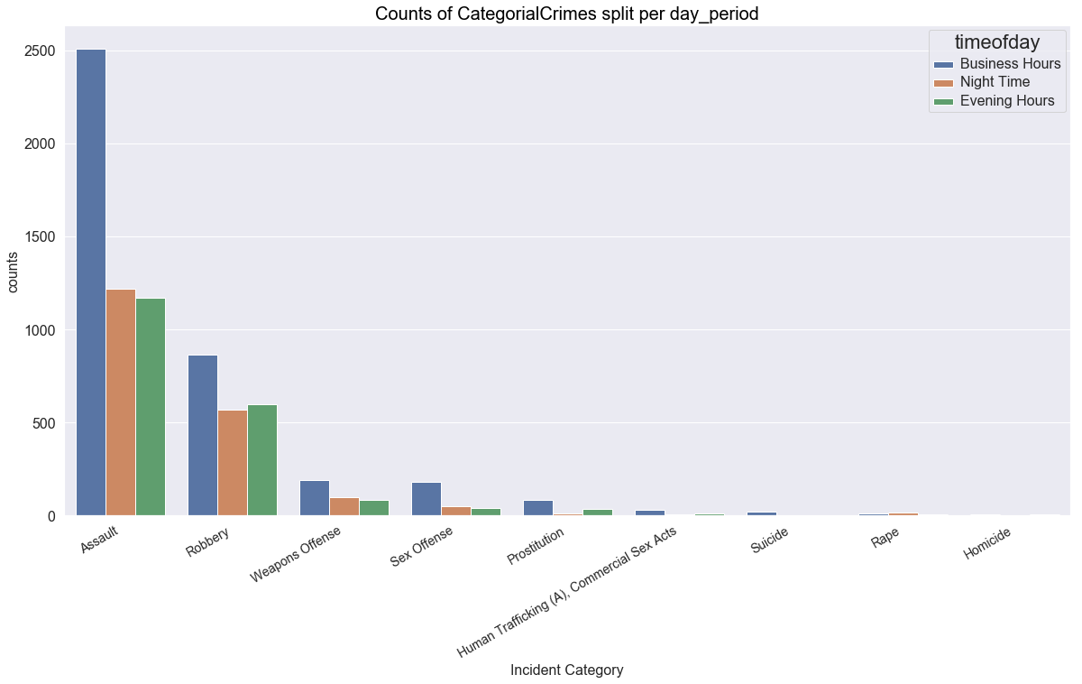
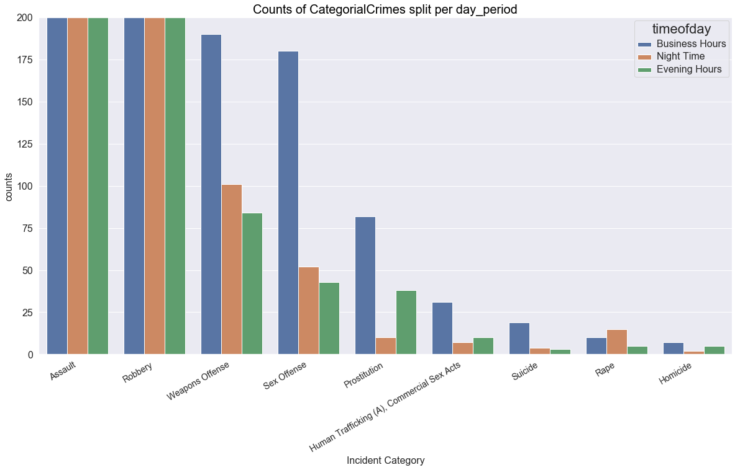
Crime Trend Analysis

Slide 9
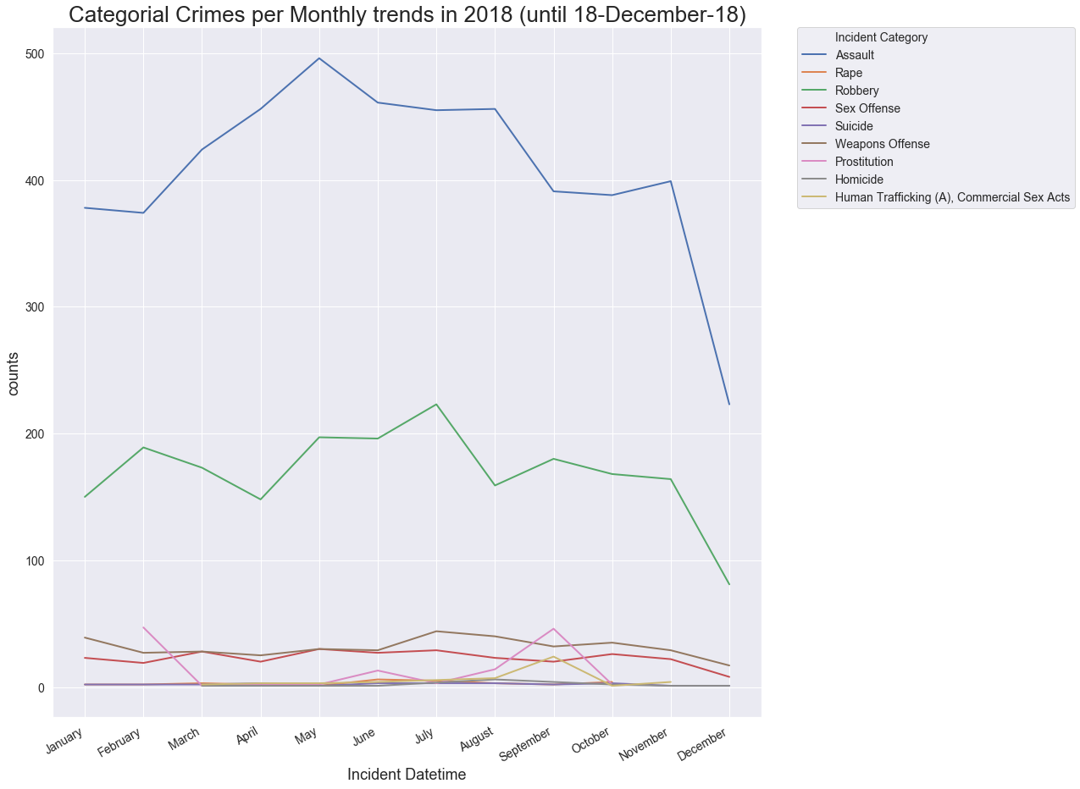

Slide 10
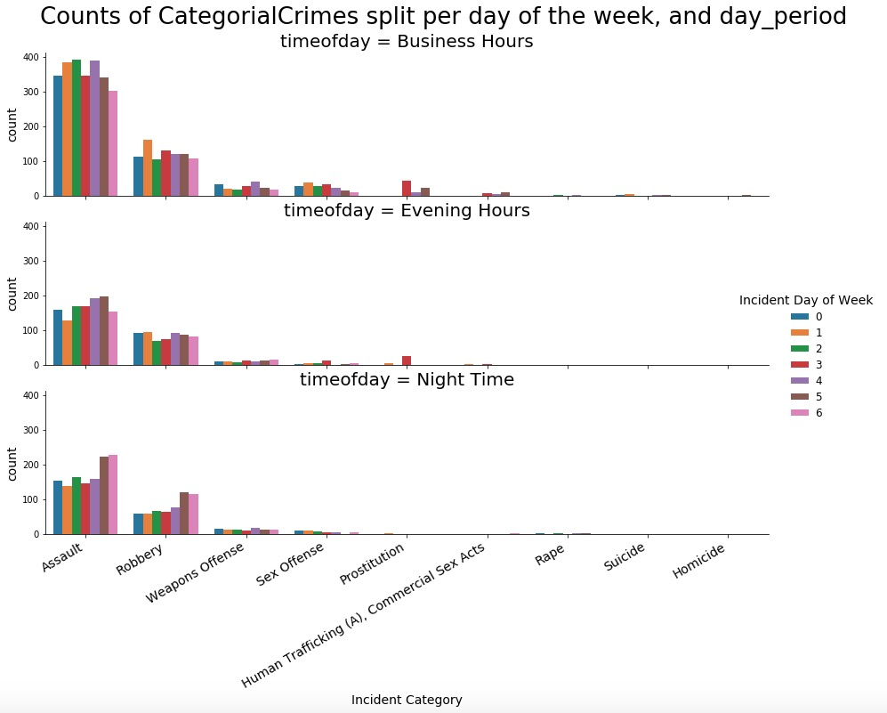
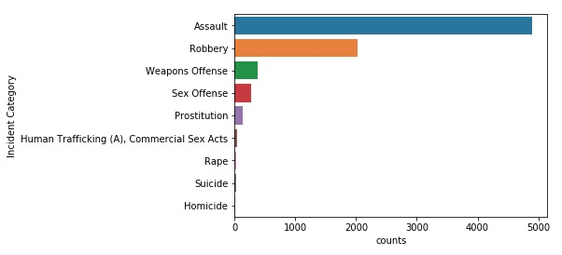

Slide 11
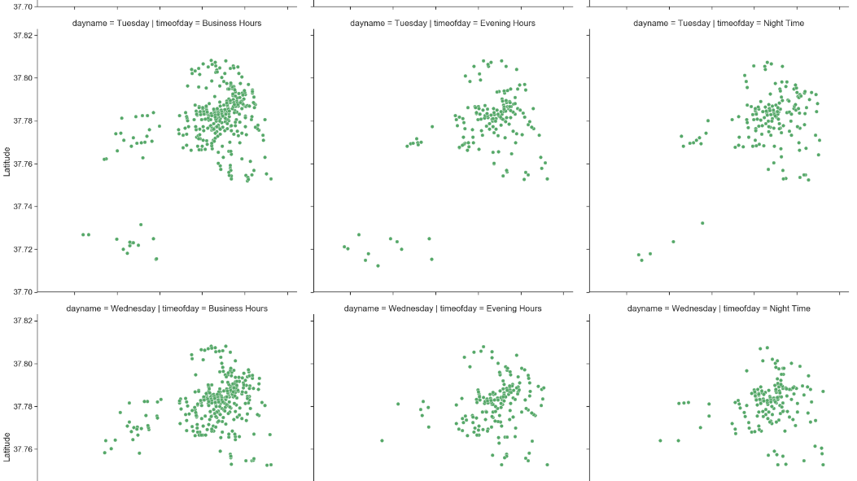

Slide 12
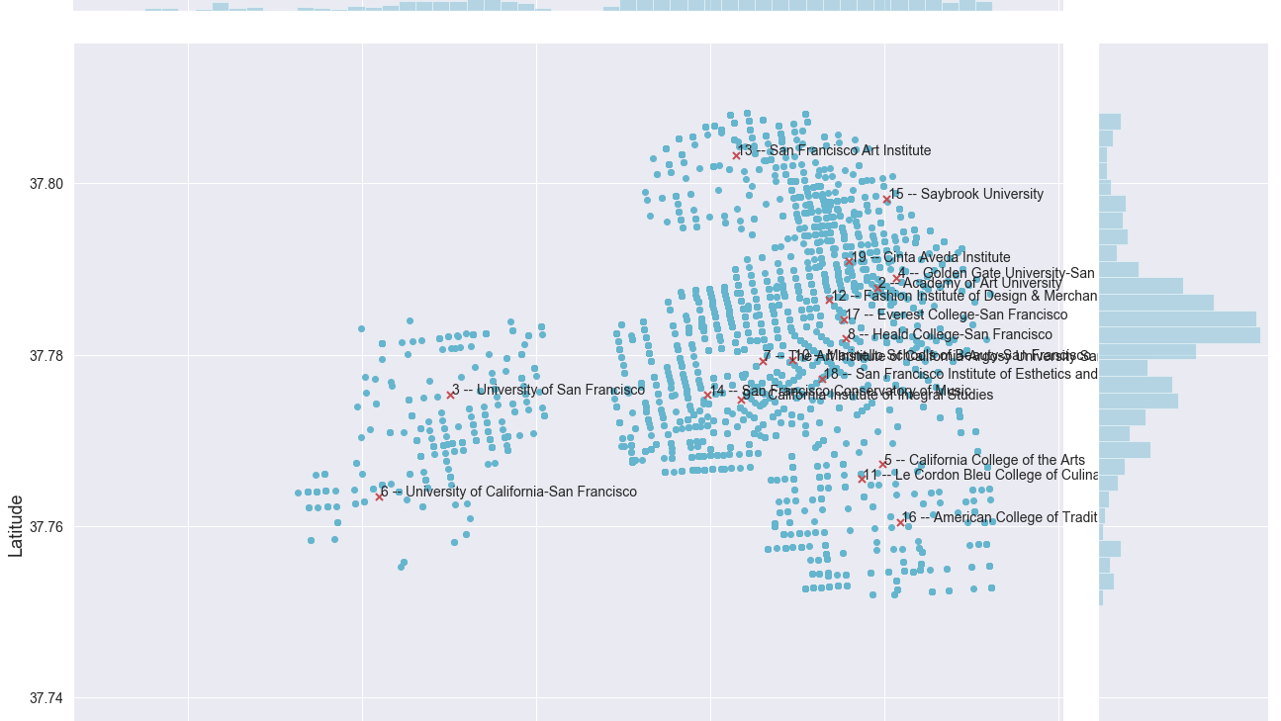

Slide 13
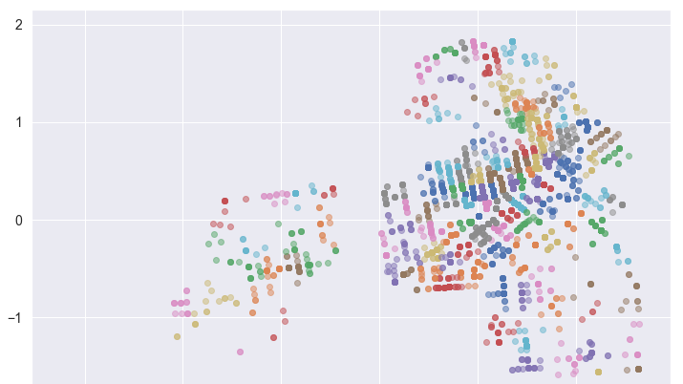

Slide 14
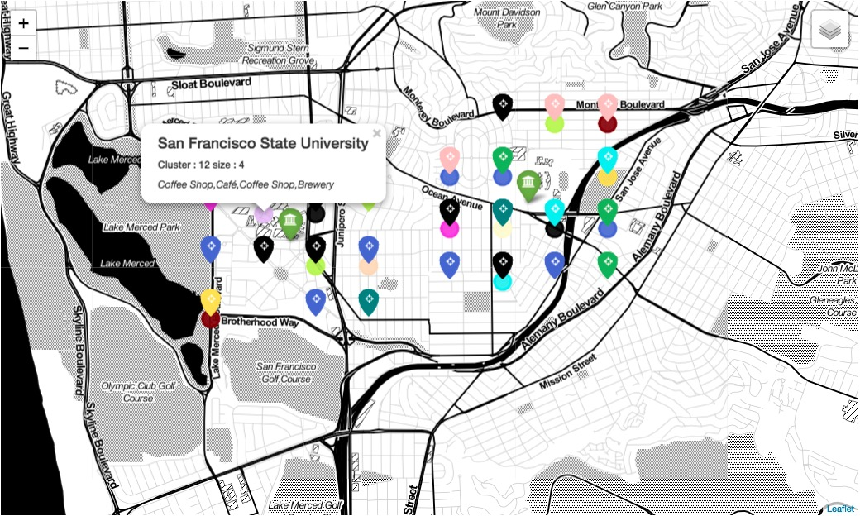
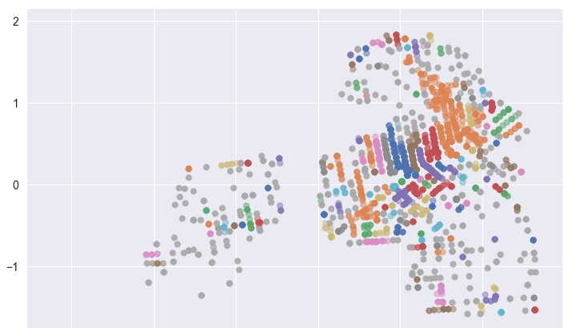
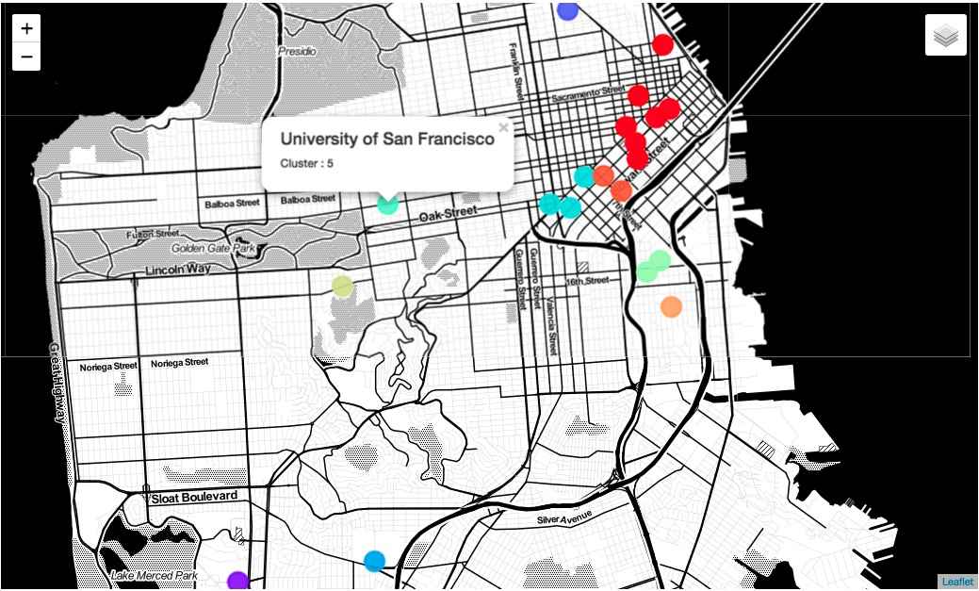
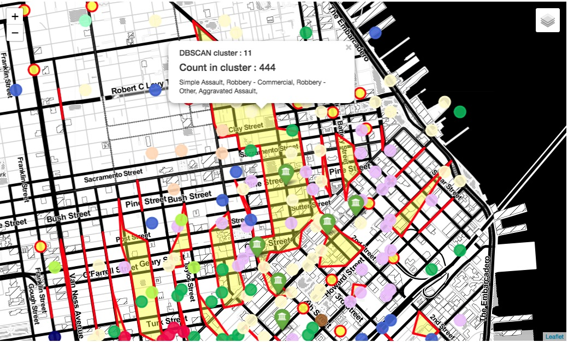

Slide 15
Conclusion
Concluding that the research question is successfully answered, a presentable solution has been developed to provide insight into the venue and crime climates in the neighborhoods of educational locations for investors in San Francisco, who can explore the neighborhoods visually and interpret the provided labelled clusters with quantified venue and crime incident counts. This should help a security conscious individual to make an educated choice, or to possibly avoid some streets. In the current representations a user-selectable crime-layer is optimal, because of the different clustering characteristics and a user can decide which clustering method is personally preferable. A default clustering method is suggested and is the DBSCAN clustering since this algorithm ignores noise in the visualizations and produces the least unintended effect of crime-climate over appreciation.

